Slide 1
Technology tools
Virtual Management: bridge to 21st Century Organization

Slide 2
Topics
Lecture 8
Categories of collaboration tool
Case Study CISSE International Conference
Text Analytics
Lecture 9
Web conferencing
Forums, wikis and blogs
Email and Technologies for Managing Email
Collaboration Platforms
Integrated Collaboration Environments (ICE)
[1] Baasch, W (2002). Group Collaboration in Organizations: Architectures, Methodologies, and Tools. Monterey, CA: Naval Postgraduate School.

Slide 3
Web Conferencing tools

Slide 4
What is Web Conferencing
Web Conferencing is a synchronous collaboration tool that enables multiple participants, who are connected to the Web, to take part in a real-time conference
It offers a less expensive alternative to travel for face-to-face meetings
Standard functionality includes
Ability of all participants to see the same screen simultaneously
Whiteboard for sharing ideas
Ability to assign and reassign presenters who can share applications and their desktops, in other words present those artifacts to other participants
[1] Business Software (2014). Top 10 Web Conferencing Software Report. Retrieved from http://webconferencing.org/
[2] Strom, D. (2012). Web-based conferencing comes of age. Network World, 29(18), 23-27. EBSCO
[3] Baasch, W (2002). Group Collaboration in Organizations: Architectures, Methodologies, and Tools. Monterey, CA: Naval Postgraduate School. Kindle Edition.

Slide 5
What is Web Conferencing
Other functionality that is often included
The ability to co-browse the Web or jointly have all participants see the same Web pages at the same time with automatic synchronization of states and frames
Integrated chat
Ability to record the sessions
Schedule meetings
Report on attributes of the meetings
Security features
Support for a variety of audio options
[1] Business Software (2014). Top 10 Web Conferencing Software Report. Retrieved from http://webconferencing.org/
[2] Strom, D. (2012). Web-based conferencing comes of age. Network World, 29(18), 23-27. EBSCO
[3] Baasch, W (2002). Group Collaboration in Organizations: Architectures, Methodologies, and Tools. Monterey, CA: Naval Postgraduate School. Kindle Edition.

Slide 6
Web conferencing options
In choosing the type of Web conferencing solution, your needs are the most important factor
You may not need all the features offered by leading vendors, so do your own requirements elicitation to identify essential and optional features
Began as whiteboard sharing in web browsers and chat, separate teleconference
Added screen sharing, window sharing, application sharing, synchronized web cerfing, video presence, VoIP, integrated teleconference, recording
This software is becoming more user friendly, less costly with more functionality
[1] Business Software (2014). Top 10 Web Conferencing Software Report. Retrieved from http://webconferencing.org/
[2] Strom, D. (2012). Web-based conferencing comes of age. Network World, 29(18), 23-27. EBSCO
[3] Baasch, W (2002). Group Collaboration in Organizations: Architectures, Methodologies, and Tools. Monterey, CA: Naval Postgraduate School. Kindle Edition.

Slide 7
Web conferencing offerings
In this section, we will review some of the leading Web Conferencing Software.
Feature comparisons of dozens of offerings can be found at
Wikipedia
Webconferencing.org
G2Crowd Collaboration
Capterra
And other sites.
The software costs approximately $60 per month for most of the offerings and several of them are free
[1] Business Software (2014). Top 10 Web Conferencing Software Report. Retrieved from http://webconferencing.org/
[2] Strom, D. (2012). Web-based conferencing comes of age. Network World, 29(18), 23-27. EBSCO
[3] Baasch, W (2002). Group Collaboration in Organizations: Architectures, Methodologies, and Tools. Monterey, CA: Naval Postgraduate School. Kindle Edition.

Slide 8
Web conferencing: four usage scenarios
Strom categorized these offerings into four usage scenarios
Ad hoc simple desktop collaboration with single presenter
LogMeIn Join.me and Cisco WebEx excel because they are easy to setup
Workgroup collaboration with multiple presenters who need to control shared desktop
All products do this well, each exceling in some functions of another
Recording and playback of Web conference content
Adobe Connect is the best at recording
Large scale webinar or presentation
Adobe Connect and Citrix GoToWebinar are best
[1] Business Software (2014). Top 10 Web Conferencing Software Report. Retrieved from http://webconferencing.org/
[2] Strom, D. (2012). Web-based conferencing comes of age. Network World, 29(18), 23-27. EBSCO
[3] Baasch, W (2002). Group Collaboration in Organizations: Architectures, Methodologies, and Tools. Monterey, CA: Naval Postgraduate School. Kindle Edition.

Slide 9
Web conferencing: GVT Usage Scenarios
Global virtual teams will be small and have limited need for large scale Webinars or recording and playback.
Additionally, multiple presenters will need to control meetings from the various locations.
The most likely scenario for global virtual teams is Strom’s workgroup collaboration with multiple presenters who need to control shared desktop
[1] Business Software (2014). Top 10 Web Conferencing Software Report. Retrieved from http://webconferencing.org/
[2] Strom, D. (2012). Web-based conferencing comes of age. Network World, 29(18), 23-27. EBSCO
[3] Baasch, W (2002). Group Collaboration in Organizations: Architectures, Methodologies, and Tools. Monterey, CA: Naval Postgraduate School. Kindle Edition.

Slide 10
Web Conferencing - - -
vs Video Conferencing
vs Web Casting

Slide 11
Adobe Connect
Connect is robust and can support large conferences with substantial reporting capabilities on the conference
It is more difficult to setup so will not be effective for small, ad hoc conference needs
Offers comprehensive reporting on meeting usage, audience engagement and training activities that are relevant for e-Learning work
Has the most complete features for recording and archiving meeting content
Limited audio offerings: use the built-in audio on your device (PC or Smart phone) or purchase at extra cost an external audio service
Mobile clients have a consistent look and feel
Connect is one of the more expensive offerings
[1] Business Software (2014). Top 10 Web Conferencing Software Report. Retrieved from http://webconferencing.org/
[2] Strom, D. (2012). Web-based conferencing comes of age. Network World, 29(18), 23-27. EBSCO
[3] Baasch, W (2002). Group Collaboration in Organizations: Architectures, Methodologies, and Tools. Monterey, CA: Naval Postgraduate School. Kindle Edition.

Slide 12
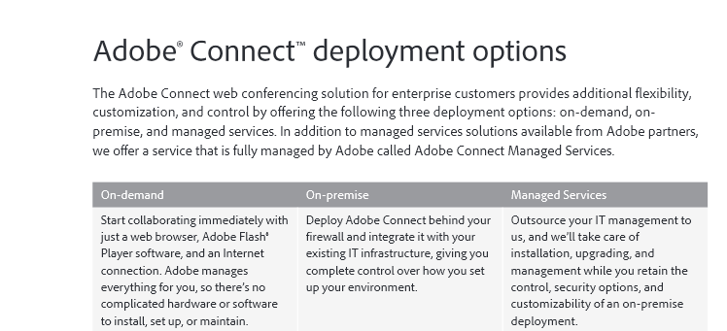
Adobe Connect has on-premise version

Slide 13
Adobe Connect
As a Web Conferencing Solution
Potential applications

Slide 14
Cisco Webex
Easy meeting setup
Easy to attach files and provision each participant
Easy to record and archive meeting
Mobile clients have different user interfaces and cannot send live video
Needs Java for the Web browser, which is what controls the meetings
Less expensive than Adobe Connect, Citrix GotoMeeting, Intercall Unified Meeting
Cost competitive with LogMeIn Join.me, Microsoft Lync and Vyew
Offers a free version for small groups (less than three)
[1] Business Software (2014). Top 10 Web Conferencing Software Report. Retrieved from http://webconferencing.org/
[2] Strom, D. (2012). Web-based conferencing comes of age. Network World, 29(18), 23-27. EBSCO
[3] Baasch, W (2002). Group Collaboration in Organizations: Architectures, Methodologies, and Tools. Monterey, CA: Naval Postgraduate School. Kindle Edition.

Slide 15
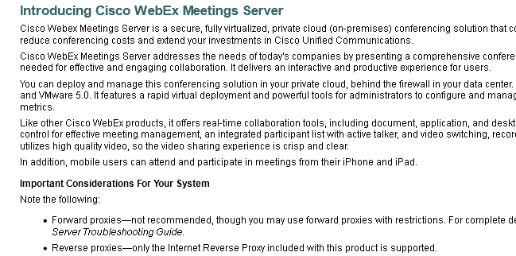
Cisco webex has on-premise

Slide 16
Cisco Webex
Very different motif than Adobe Connect or Blackboard Collaborate

Slide 17
Citrix gotomeeting
GoToMeeting is for smaller workgroups. Citrix offers GoToWebinar for large scale conferences
Easy to setup a meeting once the desktop client is installed.
There is no Web client; you must download and install a desktop client
Recordings are saved to the host participant’s local hard drive. A second step must be taken to share the recording with other members. Likewise for chat log
In contrast, Connect and Webex have ability to easily store recordings in the cloud so instantly shared
Cost competitive with Adobe Connect and InterCall Unified Meeting, more expensive than the rest
[1] Strom, D. (2012). Web-based conferencing comes of age. Network World, 29(18), 23-27. EBSCO
[2] Nuckles, B. (2014). Affordable Video Conferencing Solutions. Business News Daily.

Slide 18
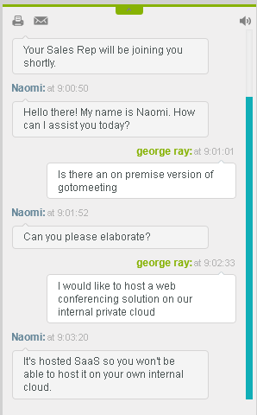
Gotomeeting has no on-premise

Slide 19
InterCall unified Meeting
Better for smaller workgroups
Least intuitive to use
Poor screen refresh rate
Need to download and install a desktop client to host a meeting
Host can share Webcam and has a scheduling feature
Supports three audio options: built-in device, dialin to conference call, system calls you
Cost competitive with Adobe Connect and Citrix GoToMeeting, more expensive than the rest
For less cost, Vyew and Join.me offer better small group conferencing
[1] Strom, D. (2012). Web-based conferencing comes of age. Network World, 29(18), 23-27. EBSCO
[2] Nuckles, B. (2014). Affordable Video Conferencing Solutions. Business News Daily.

Slide 20
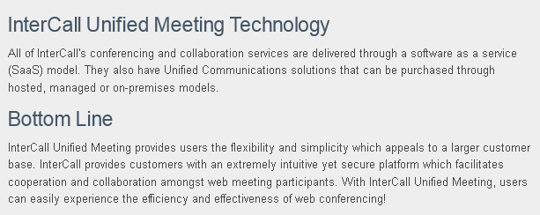
Unified meeting has on-premise

Slide 21
LogMeIn Join.me
Better for smaller workgroups
Effective user interface
Easy to setup meetings, share desktops and start the conversation
Free service for computer audio only and no meeting scheduling, only sharing of entire screen
Meeting setup is done through a Web client
Limit of 250 participants
One of the most cost competitive offerings
[1] Strom, D. (2012). Web-based conferencing comes of age. Network World, 29(18), 23-27. EBSCO
[2] Nuckles, B. (2014). Affordable Video Conferencing Solutions. Business News Daily.

Slide 22
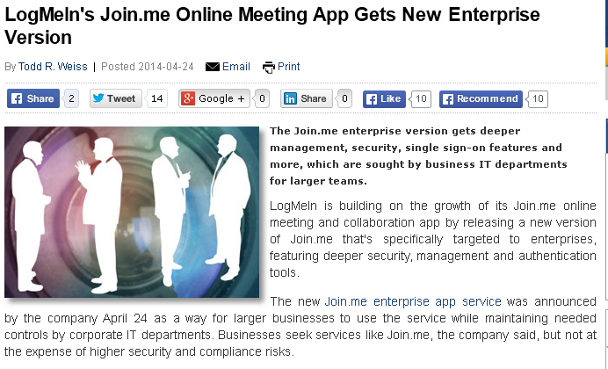
Join.me has enterprise versions
Not On-premise
Still Cloud hosted
Beefed up security

Slide 23
Microsoft lync
Difficult to install; it may conflict with earlier versions of Microsoft Office
Likewise, there are reports of clients crashing in use
Lync 2013 is part of the Microsoft Office 365 SaaS package but there are older versions in the field: Mac 2011 and Mobile 2010
Lync 2013 only works on a Windows 7 or 8 PC
Uses the spare tile interface that is not intuitive to everyone
One of the more costly offerings with the added requirement that system participants register with Microsoft
Has trouble keeping PowerPoint slide presentations in sync
Web clients cannot be a presenter or load files into shared meeting space
[1] Strom, D. (2012). Web-based conferencing comes of age. Network World, 29(18), 23-27. EBSCO
[2] Nuckles, B. (2014). Affordable Video Conferencing Solutions. Business News Daily.

Slide 24
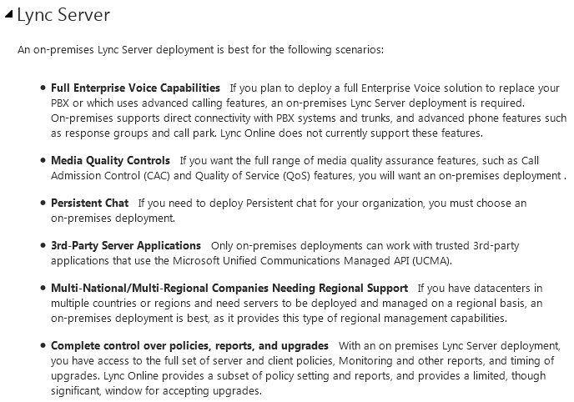
Lync has on-premise

Slide 25
Lync Architecture Document
Example of infrastructure planning

Slide 26
Skype
Skype is short for Sky peer-to-peer
For workgroups and not large conferences
Free version is video chat
For $9.99 per month it becomes a Web conferencing tool with
Screen sharing with up to 10 people
Group video calling for a maximum of 10 people
Audio conferencing with up to 25 people
Text messaging with up to 300 people
No session recording
Purchased by Microsoft and now federating with Lync
[1] Strom, D. (2012). Web-based conferencing comes of age. Network World, 29(18), 23-27. EBSCO
[2] Nuckles, B. (2014). Affordable Video Conferencing Solutions. Business News Daily.

Slide 27
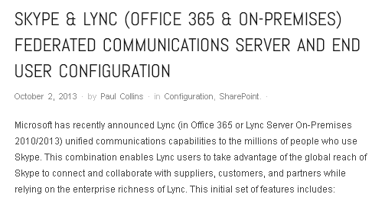
Skype Lync federation has on-premise

Slide 28
Vyew
For workgroups not large conferences
Very easy meeting setup
Persistent meeting rooms which participants can access over a period of days
User friendly navigation of conference functionality
Comprehensive access controls
Integrated audio-conferencing
Integrated real-time chat
Share entire desktop or a region within it
Can switch presenters
No mobile client: based on Flash
Free version supports 5 concurrent users and 10 rooms for sharing documents
[1] Strom, D. (2012). Web-based conferencing comes of age. Network World, 29(18), 23-27. EBSCO
[2] Nuckles, B. (2014). Affordable Video Conferencing Solutions. Business News Daily.

Slide 29
Fuse
Easy setup and use
Supports a maximum of 250 participants in virtual meetings with 12 concurrent video feeds
Share screen or program
Set of markup tools for co-authoring documents or videos
Participants can join from almost any Web connected device
Can record sessions
Cost ranges from free for 3 participants to $20 per month for 20 users and 12 concurrent video feeds and $40 per month for 250 users and 12 feeds
[1] Strom, D. (2012). Web-based conferencing comes of age. Network World, 29(18), 23-27. EBSCO
[2] Nuckles, B. (2014). Affordable Video Conferencing Solutions. Business News Daily.

Slide 30
Forums, wikis, blogs

Slide 31
Forums, blogs, and wikis
These are online collaboration tools that provide a digital workspace for teams to jointly create, modify, review and comment on documents, videos, ideas, processes, and other deliverables and management activities in the group
Without tools like blogs, wikis or forums a global virtual team would be inundated with emails and unnecessary information and waste time setting up address books and rules for who to send what
A blog is a discussion workspace with short posts displayed in reverse chronological order. Typically, posts are not meant to be changed after being published
A wiki is a digital workspace not organized as a series of entries but instead has very flexible organization allowing a group to add organization and content as needed
A forum is a discussion workspace with entries organized into conversations called topics. They have a formal structure: topics, subtopics and messages
[1] Fichter, D. (2005). The Many Forms of E-Collaboration: Blogs, Wikis, Portals, Groupware, Discussion Boards, and Instant Messaging. ONLINE, 48-50. EBSCO

Slide 32
Forums
Forums provide a digital workspace for virtual team members to post and organize entries
They allow the users to organize messages into topics and topics into categories
Many also offer member directories and private messaging between members.
Likewise, many offer a WYSIWYG editor and the ability to upload images
Like Web conferencing solutions, forum models include Software as a Service as well as on-premise
[1] Myttn, D. (2003). Forum Software Roundup. Retrieved from http://www.sitepoint.com/forum-software-roundup/

Slide 33
Demo
Comparing Popular Forums

Slide 34
Blogs
Short for Weblog, blogs allow authors to post a series of messages that are not organized into topics and categories but like a log book in the military, blogs are a chronological stream of postings
Designated authors can create posts, non-authors can read or comment on these posts
In this manner, they allow a two-way conversation between parties
A post can link to outside resources or to other postings on the blog
The blog itself can have links to related sites, this is known as a blogroll
Older content is usually archived automatically and available as a series of links on the blog

Slide 35
Demo
Comparing Popular Blogs

Slide 36
Wikis
Wikis are a content management system that enable collaborative authoring of content
Once a listing is created, participants can add to it, remove from it or modify parts of it
Unlike a blog, there is no owner or group of owners; instead, all members of the wiki can take action in the wiki
The wiki is for presenting content and for engaging users to become part of the creative process
It relies on the Law of Many Eyeballs to correct discrepancies
Wikis make it easy to link to other content in the wiki

Slide 37
Demo
Comparing Popular Wikis

Slide 38
Tools to Manage email

Slide 39
Email issues
Email systems are designed to send and receive messages.
They introduce a risk that inappropriate content is sent to groups outside the organization
They were not designed for long-term storage, record management or discovery
Email is organized by user, with security boundaries to protect privacy and this makes it difficult for other users to search and access all email
Email systems tend to lose performance and stability as the volume of their data stores increases
They lack features to lock an email or block of emails in response to legal proceedings: the United States IRS is a recent example of this
[1] Wilkens, J (2008). Technologies for Managing Email. ARMA International. Retrieved from EBSCO

Slide 40
Email archival
These systems copy email to an archival repository ; and possibly remove it from the email system leaving a stub that links to the repository copy
The archival system will be indexed for rapid retrieval, can provide search across user boundaries, and undup messages
These systems can also secure the archived emails to preserve the content from alteration
Emails are selected for archival according to company rules or statutory requirements.
Email repositories in large organizations can reach the terabytes of data
[1] Wilkens, J (2008). Technologies for Managing Email. ARMA International. Retrieved from EBSCO

Slide 41
Email management/compliance systems
Implement email and communications policies of an organization
Email policy must address appropriate use, records retention and disposition, accessibility, automatic redirection, and transmittal of sensitive or confidential information
Email management or compliance systems can be configured to scan email for violations of the policy
Examples might be the use of offensive language in emails that would reflect poorly on the organization such as sexist, racist or in appropriate political commentary
Other violations might be the inclusion of confidential or intellectual property material
[1] Wilkens, J (2008). Technologies for Managing Email. ARMA International. Retrieved from EBSCO

Slide 42
Email discovery systems
These systems enhance the search of email collections with indexing, and the ability to search multiple user’s emails
They also support legal proceedings by allowing litigation holds to be applied and removed on subsets of the email repository
Searching can be done through traditional full-text search as well as with meta-data that has been applied to the emails
They also allow the organization to redact, which is to remove or obscure certain information from an email before it is released
[1] Wilkens, J (2008). Technologies for Managing Email. ARMA International. Retrieved from EBSCO

Slide 43
Email security systems
Scan incoming email for viruses, spam or other malware
They also protect information content in emails with encryption
Messages can be encrypted based on rules or metadata content
These systems can also allow users to digitally sign emails
[1] Wilkens, J (2008). Technologies for Managing Email. ARMA International. Retrieved from EBSCO

Slide 44
Collaboration platforms

Slide 45
Uses of collaboration platforms
Collaborative development
Document management
Records management
Digital asset management
Web site and portal content management
Business process and lifecycle management
Search
Modelling
[1] Newton, J (2009). The Return of Innovation and Research into Content Mgmt with Open Source. The Oxford Group.

Slide 46
Sharepoint
Sharepoint was a replacement for Microsoft’s Site Server and began its career with library services for document management
Today it dominates this market and offers
Content services: Libraries, enterprise metadata, document sets, Web and portal publishing controlled by digital asset management, records management
Search services: to easily locate relevant content in an organizations knowledge stores such as file shares, Web sites, directories, repositories
Insights services: business intelligence functionality for organizing, analyzing and presenting key information for decision making
Composite services: Light application development, workflow, connectivity services, Infopath forms, external lists
[1] Withlee, K (2011). Microsoft Sharepoint Development. Hoboken: Wiley.

Slide 47
Lotus (now IBM) connections
IBM/Lotus Connections was introduced as a social networking system
It had a look and feel like Facebook with built in homepages, personal profiles, Wikis, Blogs, Forums, and communities
IBM owns Filenet and integrated Filenet into the mix to now enable Enterprise Content Management capabilities
Like SharePoint, Connections can federate knowledge from many diverse sources
It can manage task work through its Activities feature and with its Files feature can provide library services, storing, sharing, versioning of content
It also has crowd sourcing capabilities for ideation
[1] Altenburg, F, et al (2012). Making the Move to Connections 4.5 and IBM Connections Content Manager. IBM Redbook.

Slide 48
Alfresca
Open source solution
Solid business document repository
Alfresca provides these services:
Content control
Collaboration across your company
Information sharing
Business process automation
Compliance throughout the lifecycle of the content
[1] Newton, J (2009). The Return of Innovation and Research into Content Mgmt with Open Source. The Oxford Group.
[2] Pratyush (2014). Alfresco vs Sharepoint vs Nuxeo – Enterprise Content Management Comparison. Retrieved from http://www.algoworks.com/blog/alfresco-vs-sharepoint-vs-nuxeo/

Slide 49
Integrated Collaborative Environments (Ice)

Slide 50
Integrated collaboration environments
The current market trend is to provide an integrated access to the wide variety of collaboration tools including Web conferencing, forums, document management and workflow, co-authoring, text analytics and other collaboration tools, extensible to include new offerings.
The general architecture has clients access an Integration Manager with the Web HTTP protocol and the Integration Manager orchestrates access to the collaboration tools
The Integration Manager provides a set of services to the clients by in turn connecting to the collaboration tools using Web protocols such as SOAP or REST
This is a high level and general description or pattern. Individual vendors will implement it with their own specific architectures
[1] Bridgwater, A (2014). The Changing Course of Collaboration Software. Computer Weekly.
[2] Tpocu, A (2009). Integrated Collaborative Information Systems. Retrieved from
[3] Willinger, J. (2014). 2014: The Year That Online Collaboration Tool Adoption Will Increase. ViewDo Labs.

Slide 51
Integrated collaboration environments
Client
Integration Manager
Tools
Tools
Tools
databases
Document stores
directory
[1] Bridgwater, A (2014). The Changing Course of Collaboration Software. Computer Weekly.
[2] Tpocu, A (2009). Integrated Collaborative Information Systems. Retrieved from
[3] Willinger, J. (2014). 2014: The Year That Online Collaboration Tool Adoption Will Increase. ViewDo Labs.

Slide 52
Integrated collaboration environments
The Integration Manager connects clients to virtual management tools
It is also a platform to extend the ICE to include new tools
Moreover, it provides search functionality to locate distributed knowledge wherever it resides: databases, document stores or directory
Likewise it provides filtering or other analytic logic to organize retained knowledge
[1] Bridgwater, A (2014). The Changing Course of Collaboration Software. Computer Weekly.
[2] Tpocu, A (2009). Integrated Collaborative Information Systems. Retrieved from
[3] Willinger, J. (2014). 2014: The Year That Online Collaboration Tool Adoption Will Increase. ViewDo Labs.

Slide 53
Integrated Collaboration Environment: potential future directions
Integrated Collaboration Environments support a variety of software engineering methodologies
However, there are numerous Problem Solving Methodologies
Business professionals use the systems approach
Engineers and scientists use the scientific method
It is only IT professionals who use software engineering
Future directions for ICE tools might be to include support for other problem solving methodologies

Slide 54
Integrated collaboration environments
This has been a high level and general description or pattern. Individual vendors will implement an ICE with their own specific architectures
The current trend in these tools is away from establishing a virtual relationship between people using a tool such as Web conferencing
Instead of this social aspect there is now a focus on orienting and organizing virtual teams around tasks
This is viewed as a maturation of collaboration tools from social connections to true productivity tools
They offer a variety of software engineering methods such as Kanban, Scrum, Extreme Programming or Rapid Prototyping
[1] Bridgwater, A (2014). The Changing Course of Collaboration Software. Computer Weekly.
[2] Tpocu, A (2009). Integrated Collaborative Information Systems. Retrieved from
[3] Willinger, J. (2014). 2014: The Year That Online Collaboration Tool Adoption Will Increase. ViewDo Labs.

Slide 55
Integrated collaboration environments
Tibco Tibbr is a leading ICE toolset.
Tibbr configures its platform (the tools, client gateways, integration manager) around key business metrics
These metrics include employee productivity measures, idea generation, learning, onboarding and innovation
Tibbr follows the industry trend in orienting interactions around methodologies such as Scrum, Kanban, Extreme Programming
The Tibbr Integration Manager opens access to collaboration toolsets such as Box, SharePoint, DropBox, Google Drive, WebEx and others
It is available on-premise or as a cloud service on the Web
[1] Bridgwater, A (2014). The Changing Course of Collaboration Software. Computer Weekly.
[2] Tpocu, A (2009). Integrated Collaborative Information Systems. Retrieved from
[3] Willinger, J. (2014). 2014: The Year That Online Collaboration Tool Adoption Will Increase. ViewDo Labs.

Slide 56
Integrated collaboration environments
Jive is another leading ICE offering.
Challenging the industry trend, Jive still maintains a focus on people and social relations instead of tasks or project plans
It measures social connectivity
Groups people join
Documents people read
Ideas people share
Discussion people start
It is able to recommend people (experts), discussion, document collections, or other knowledge that should be useful to you based on your profile
Jive does offer a configurable Scrum methodology for task execution
Jive is entirely cloud based and offers no on premise solution
[1] Bridgwater, A (2014). The Changing Course of Collaboration Software. Computer Weekly.
[2] Tpocu, A (2009). Integrated Collaborative Information Systems. Retrieved from
[3] Willinger, J. (2014). 2014: The Year That Online Collaboration Tool Adoption Will Increase. ViewDo Labs.

Slide 57
Integrated collaboration environments
Huddle distinguishes itself as the ICE that includes secure cross-firewall collaboration
The Huddle ICE was born in reaction to the standalone social tools which ended up being only a fire hose of information
Claude Shannon noted that information only becomes meaningful, in other words knowledge, when it is put into a conceptual framework
Like other ICEs, it is a tool to structure information into meaningful business content
It then adds collaborative services for teams to access, share, sync, work and store collections of content
[1] Shannon, C. (1948, July/October). A mathematical theory of communication. Bell System Technical Journal 27 (3), 379–423. Retrieved from http://www.alcatel-lucent.com/bstj/vol27-1948/articles/bstj27-3-379.pdf
[2] Bridgwater, A (2014). The Changing Course of Collaboration Software. Computer Weekly.
[3] Tpocu, A (2009). Integrated Collaborative Information Systems. Retrieved from
[4] Willinger, J. (2014). 2014: The Year That Online Collaboration Tool Adoption Will Increase. ViewDo Labs.

Slide 58
Integrated collaboration environments
Integrated Collaboration Environments offer a set of collaboration tools to help virtual teams
Connect and interact
Discover, access, collate, analyze, update, and store distributed knowledge
Implement performance metrics to guide the team
Offer software engineering process to organize work activity
They make business content social – shareable and discoverable – on any form factor at any time and place, securely
[1] Bridgwater, A (2014). The Changing Course of Collaboration Software. Computer Weekly.
[2] Tpocu, A (2009). Integrated Collaborative Information Systems. Retrieved from
[3] Willinger, J. (2014). 2014: The Year That Online Collaboration Tool Adoption Will Increase. ViewDo Labs.

